Slide 1



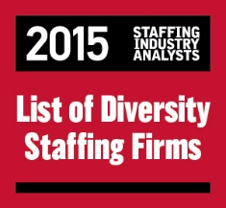


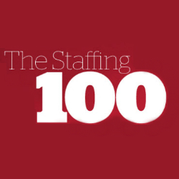






Mastech Digital + Salesforce®
LOCATIONS
ACCOLADES
EXPERTISE
Manufacturing
*Offshore locations in NOIDA, India and Chennai, India
SATISFACTION RATING
10.0
FOCUS AREAS
Sales Cloud® | Service Cloud® | Platform & Apps | Salesforce Lightning | Community Cloud
FAST FACTS
Founded in 1986 | 35 Resources | 6 Projects
1

Slide 2






Tried & Trusted
AVG. DEPLOYMENT
16 - 32 Weeks
Harmonized processes under one umbrella Eliminated swivel-chair interfaces
Branded a full-cycle, customized sales process Reduced response time to customers
Unified global Salesforce reporting across orgs. Provided visibility into divisional sales data
LIVE INSTANCES
15
EMPLOYEES ENABLED
3,000+
2

Slide 3






Customer Success Story
CHALLENGE
SOLUTION
RESULTS
Disparate source systems with no unified solution for global needs
Cloud-enabled solution with standardized business process implementation
Improved market share by creating opportunities directly from product launches, and reduced response time to customers, which garnered a lot of goodwill
INDUSTRY
Pharmaceuticals
SEGMENT
Generic Drug Manufacturing
CLOUDS
Sales Cloud, Service Cloud
3

Slide 4
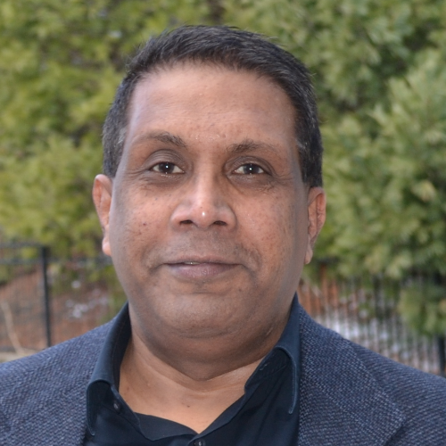



Working with Mastech Digital
Shirish.Ashwat@mastechdigital.com
+1 412.490.7946
+1 412.498.4160
Shirish Ashwat SALESFORCE PRACTICE DIRECTOR
4

